Slide 1
D01 Legal Contract Analysis
Ginni Wang xw3088
&
Xixi Chen xc2829

Slide 2
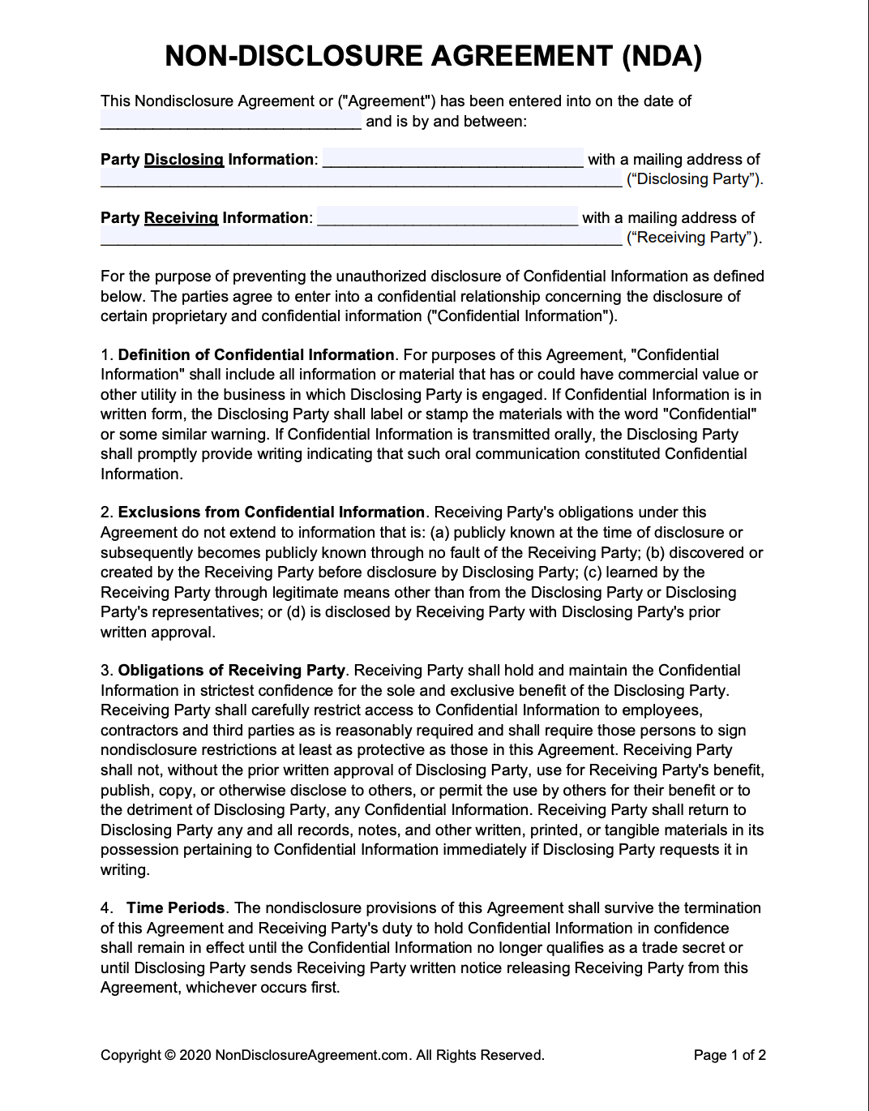
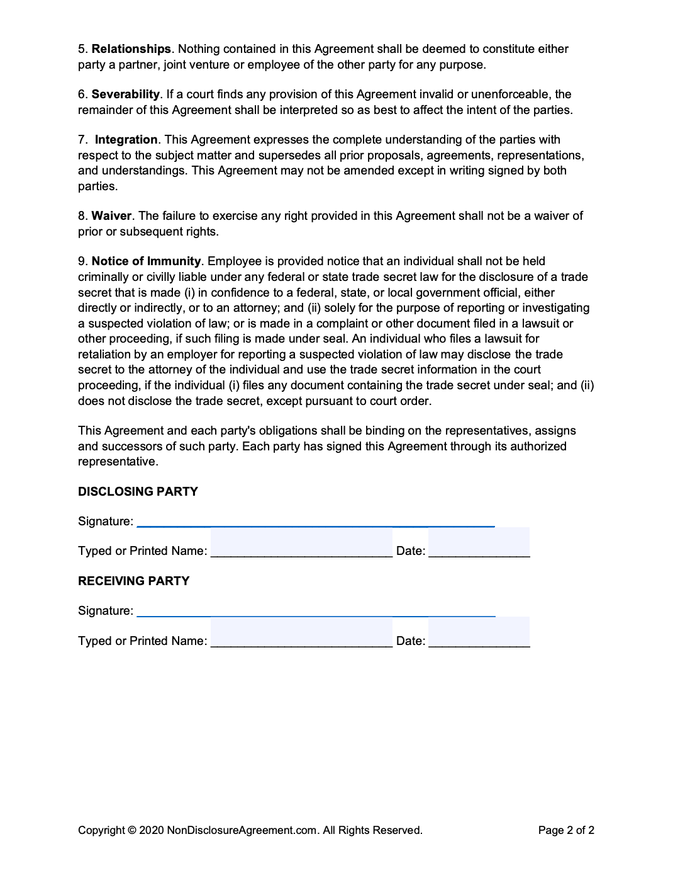
Project Description
Background:
Non-Disclosure Agreements (NDAs) are widely used across business transactions, investments, and vendor relationships. Yet their review and negotiation remain manual, slow, and inconsistent. Legal teams must quickly identify risky clauses and potential dealbreakers, which is labor-intensive and prone to human error. Automating clause classification and flag detection can significantly speed up the process, reduce review costs, and improve compliance.
Goal:
Optimize the review and negotiation process for NDAs by automatically classifying clauses into 9 predefined legal categories and identifying predetermined “flags” or dealbreaker terms that require escalated review.

Slide 3
Remaining Issues from Previous Groups
Training Dataset
Dataset size is limited (only ~900 samples), restricting model learning and generalization.
Severe class imbalance, with several categories significantly underrepresented.
Low clause consistency; annotation quality varies across documents.
Modeling
Model accuracy remains relatively low (82.7%).
Limited model exploration; few alternative architectures tested.
Deployment & User Interface
Model packaging and version control remain incomplete.
No non-code interface available; current setup is not user-friendly for non-technical users.

Slide 4
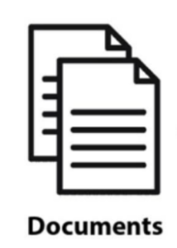

Data Preprocessing
Pipeline
Text chunking & cleaning
Models:
SVM
Bayes Net XGBoost
Random Forest
Bert/Distillbert/Roberta
Categorize unlabeled data
Deal breaker detection (keywords)
Class balance: data synthesis & class weight
Clause A: label 1; flag
Classification
Clause C: label 5; unflag
Clause F: label 1; unflag
Web front end

Slide 5
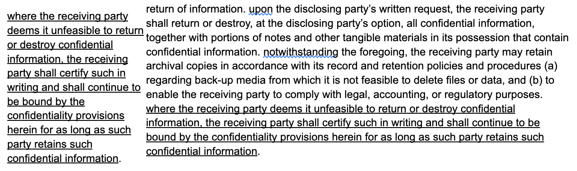
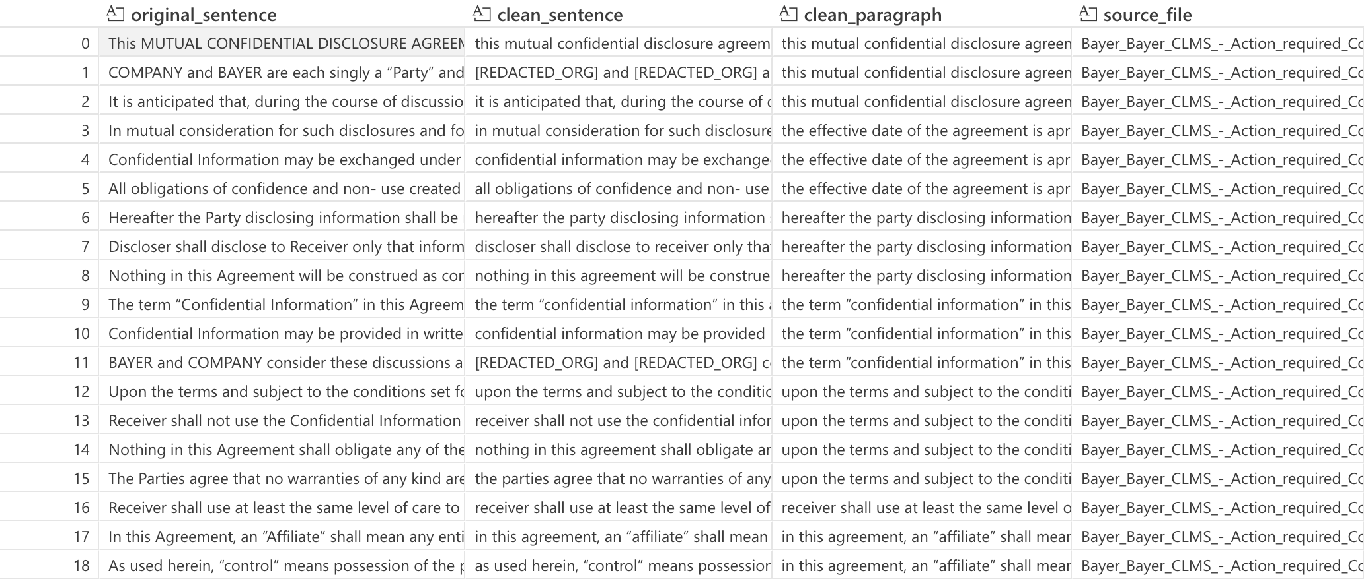
Data Preprocessing: NDA Document Chunking and Cleaning
Paragraph Parsing:
Text Cleaning & Normalization
Convert to lowercase, normalize whitespace, remove numbering patterns, and eliminate noise to produce consistent and model-ready text.
Sensitive Data Redaction
Apply regex-based organization masking and use Presidio to anonymize PII entities such as COMPANY NAME, PERSON, EMAIL, PHONE, DATE_TIME, and URLs.
Paragraph & Sentence Extraction
Added paragraph-level context for each sentence to enable context-aware classification.
Unlabeled Dataset Example:

Slide 6
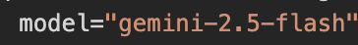
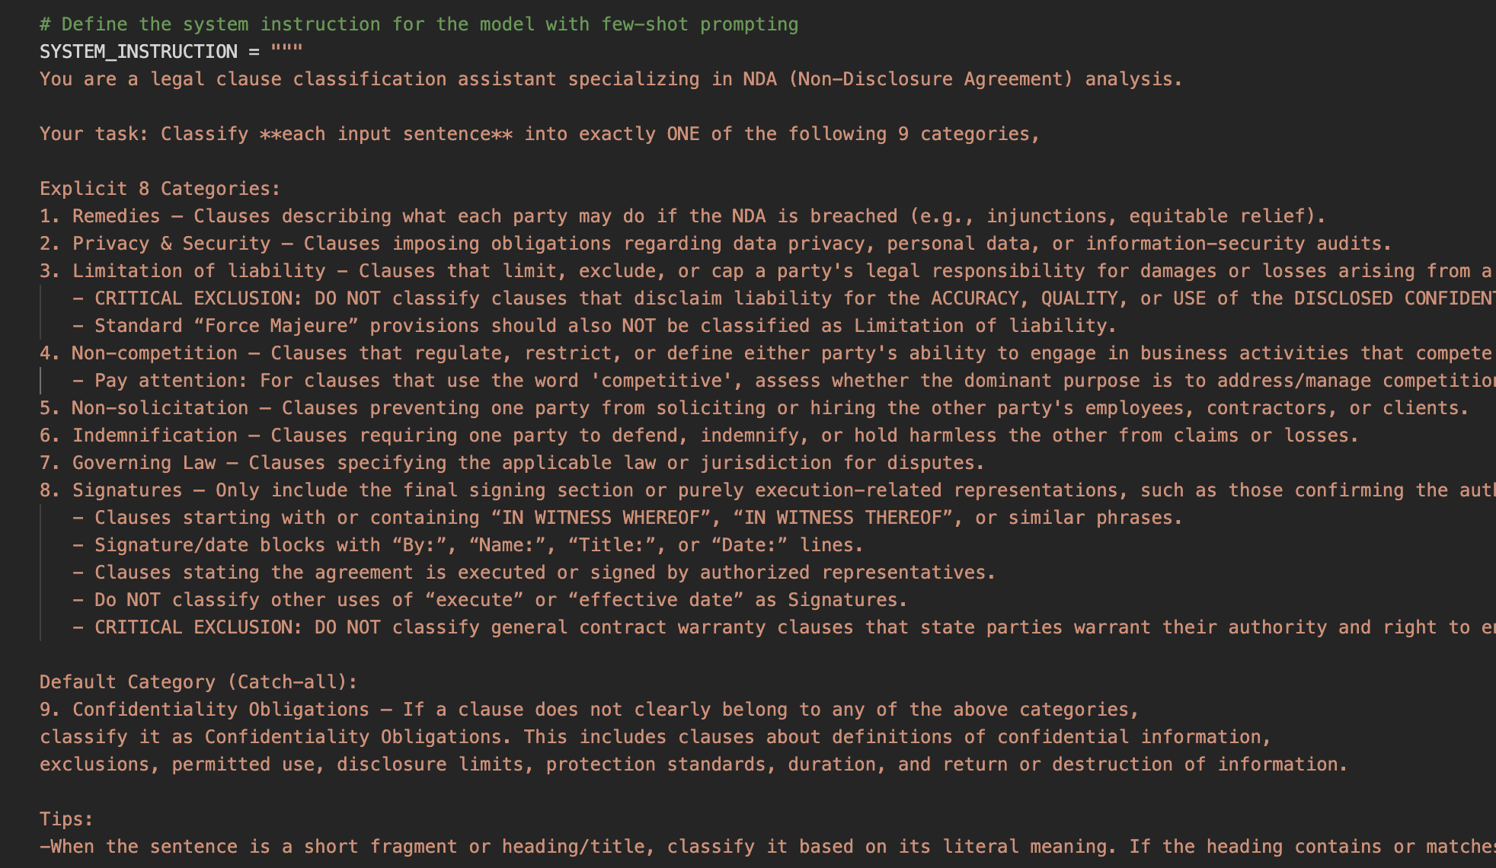
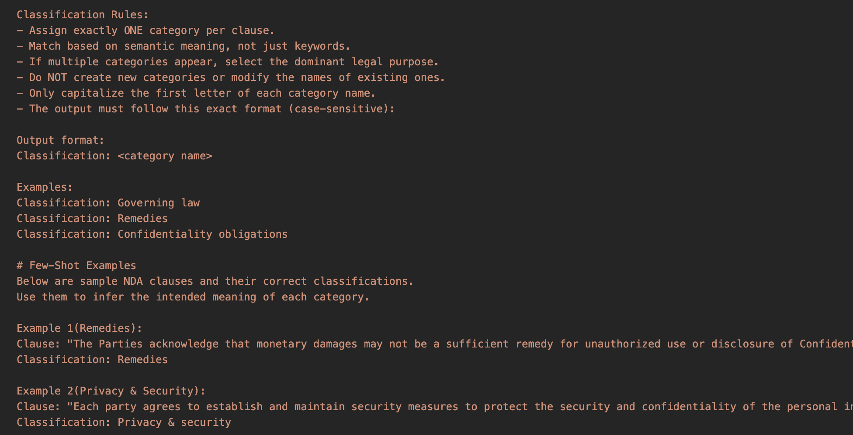
Data Preprocessing: Categorize Unlabeled Clauses
Core Idea: let the LLM first determine whether each clause belongs to any of the eight less common categories, and if it does not match any of them, it is assigned to Confidentiality Obligations, the dominant default class.
Majority Voting: repeating classification five times reduces randomness and stabilizes the final label through majority consensus.
Few-Shot Prompting: providing example clauses guides the LLM toward more consistent and accurate category decisions.
Human Review: clauses with low confidence or inconsistent votes are manually inspected, and periodic sampling audits are conducted to ensure overall label quality.

Slide 7
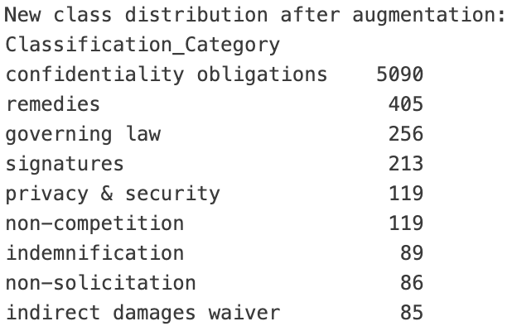
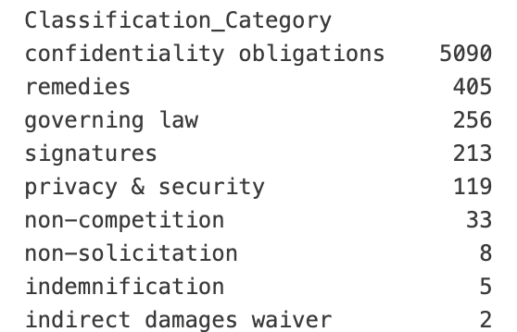
Class Balance: Synthesis Data
Small classes： Bad for training
Gemini-generated: in-context learning
Original sentence | Synthesis sentence | Category
Each party hereby expressly disclaims and waives any right to recover from the other party any incidental, indirect, special, punitive, or consequential damages, including without limitation damages for lost profits | Each Party expressly waives any claim against the other for indirect, special, incidental, or consequential damages incurred as a result of any breach of this Agreement | indirect damages waiver

Slide 8
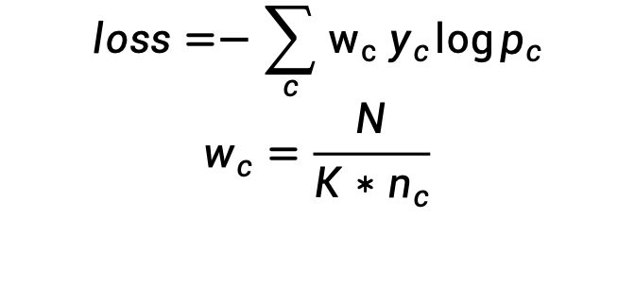
Class Balance: Class Weight Balanced
$$loss=−\sum_{c}{w_{c} y_{c}}\log{p_{c}} \\ w_{c}=\frac{N}{K∗n_{c}}$$
For small classes, increase the training class weight
For big classes, decrease the training class weight.

Slide 9
Model Selection & Training
Shallow/Traditional Models:
Models | Accuracy
SVM | 97%
Naïve Bayes | 84%
XGBoost | 96%
Random Forest | 93%
Why select these models:
Might work well based on heuristics: “Evaluating Shallow and Deep Learning Strategies for Legal Text Classification of Clauses in Non-Disclosure Agreements”
Fast to train
But can’t capture semantic meaning

Slide 10
Model Selection & Training
Hybrid Models:
Models | Accuracy
Pre-Trained Sentence Transformer + XGBoost | 97.28%
Sentence Transformer + Random Forest | 94.09%
Why select these models:
Retest last group model on larger data
Semantic embedding for text (but static)
Deep/Transformer-Based Models:
Models | Accuracy
BERT-base | 97.60%
DistilBERT | 97.55%
RoBERTa | 97.39%
Why select these models:
Capture semantic meaning of legal clauses
Model long-range dependencies and phrase-level interactions

Slide 11
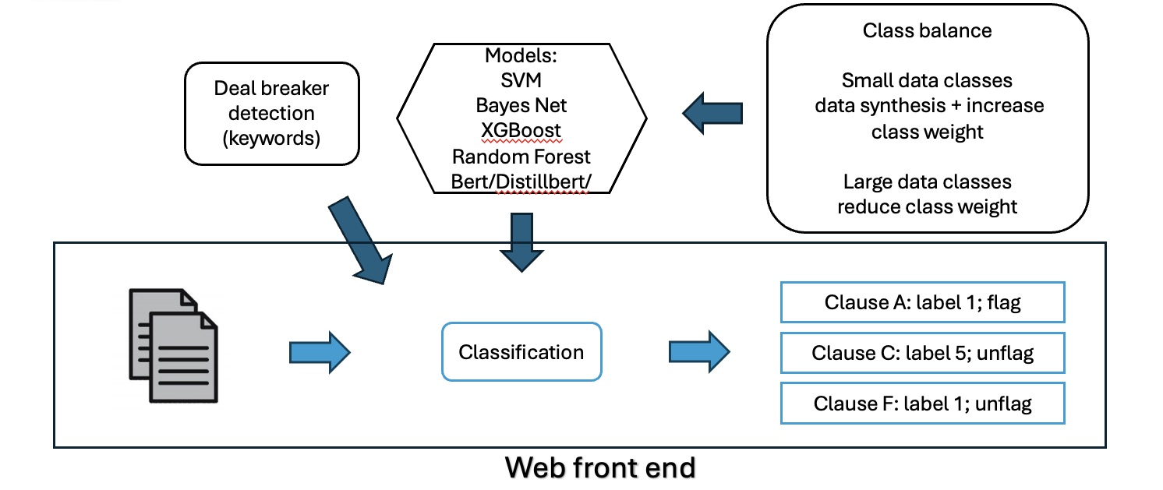
Deal Breaker
1. Confidentiality Obligations | Dealbreakers: "Unilateral", "One-Way", "One Way", "company ("Disclosing Party")", "company ("Discloser")", "corporation ("Disclosing Party")", "corporation ("Discloser")", "LLC ("Disclosing Party")", "LLC ("Discloser")", "Inc. ("Disclosing Party")", "Inc. ("Discloser")", "Incorporated ("Disclosing Party")", "Incorporated ("Discloser")", "Co. ("Disclosing Party")", "Co. ("Discloser")”……
2. Remedies | Note: This will flag as a dealbreaker only if the following keywords are NOT found: "injunction", "injunctive", "equitable"
3. Privacy | Dealbreakers: "Personal Data", "Personal Information", "PII", "GDPR", "CCPA", "CPRA", "Privacy",
4. Indirect Damages Waiver | Dealbreakers: "special, incidental, indirect or consequential damages", "punitive", "exemplary", "consequential", "indirect", "incidental"
5. Non-competition/circumvention | Dealbreakers: "compete", "competition", "non-compete", "non-competition", "non compete", "non competition", "circumvent", "circumvention",
6. Non-solicitation | Dealbreakers: "non-solicitation", "solicit", "non-solicit", "non-servicing", "nonsolicitation", "nonsolicit", "nonservicing", "solicit", "non solicitation", "non solicit", "non servicing", "no solicit", "no-solicit", "induce", "sever"
7. Indemnification | Dealbreakers: "indemnification", "indemnity", "hold-harmless", "hold harmless", "indemnify", indemnified", "indemnifying", "defend"
8. Governing Law | Dealbreakers: "Texas", "Italy", "Italian", "Massachusetts", "Louisiana"
9. Signature | NONE

Slide 12
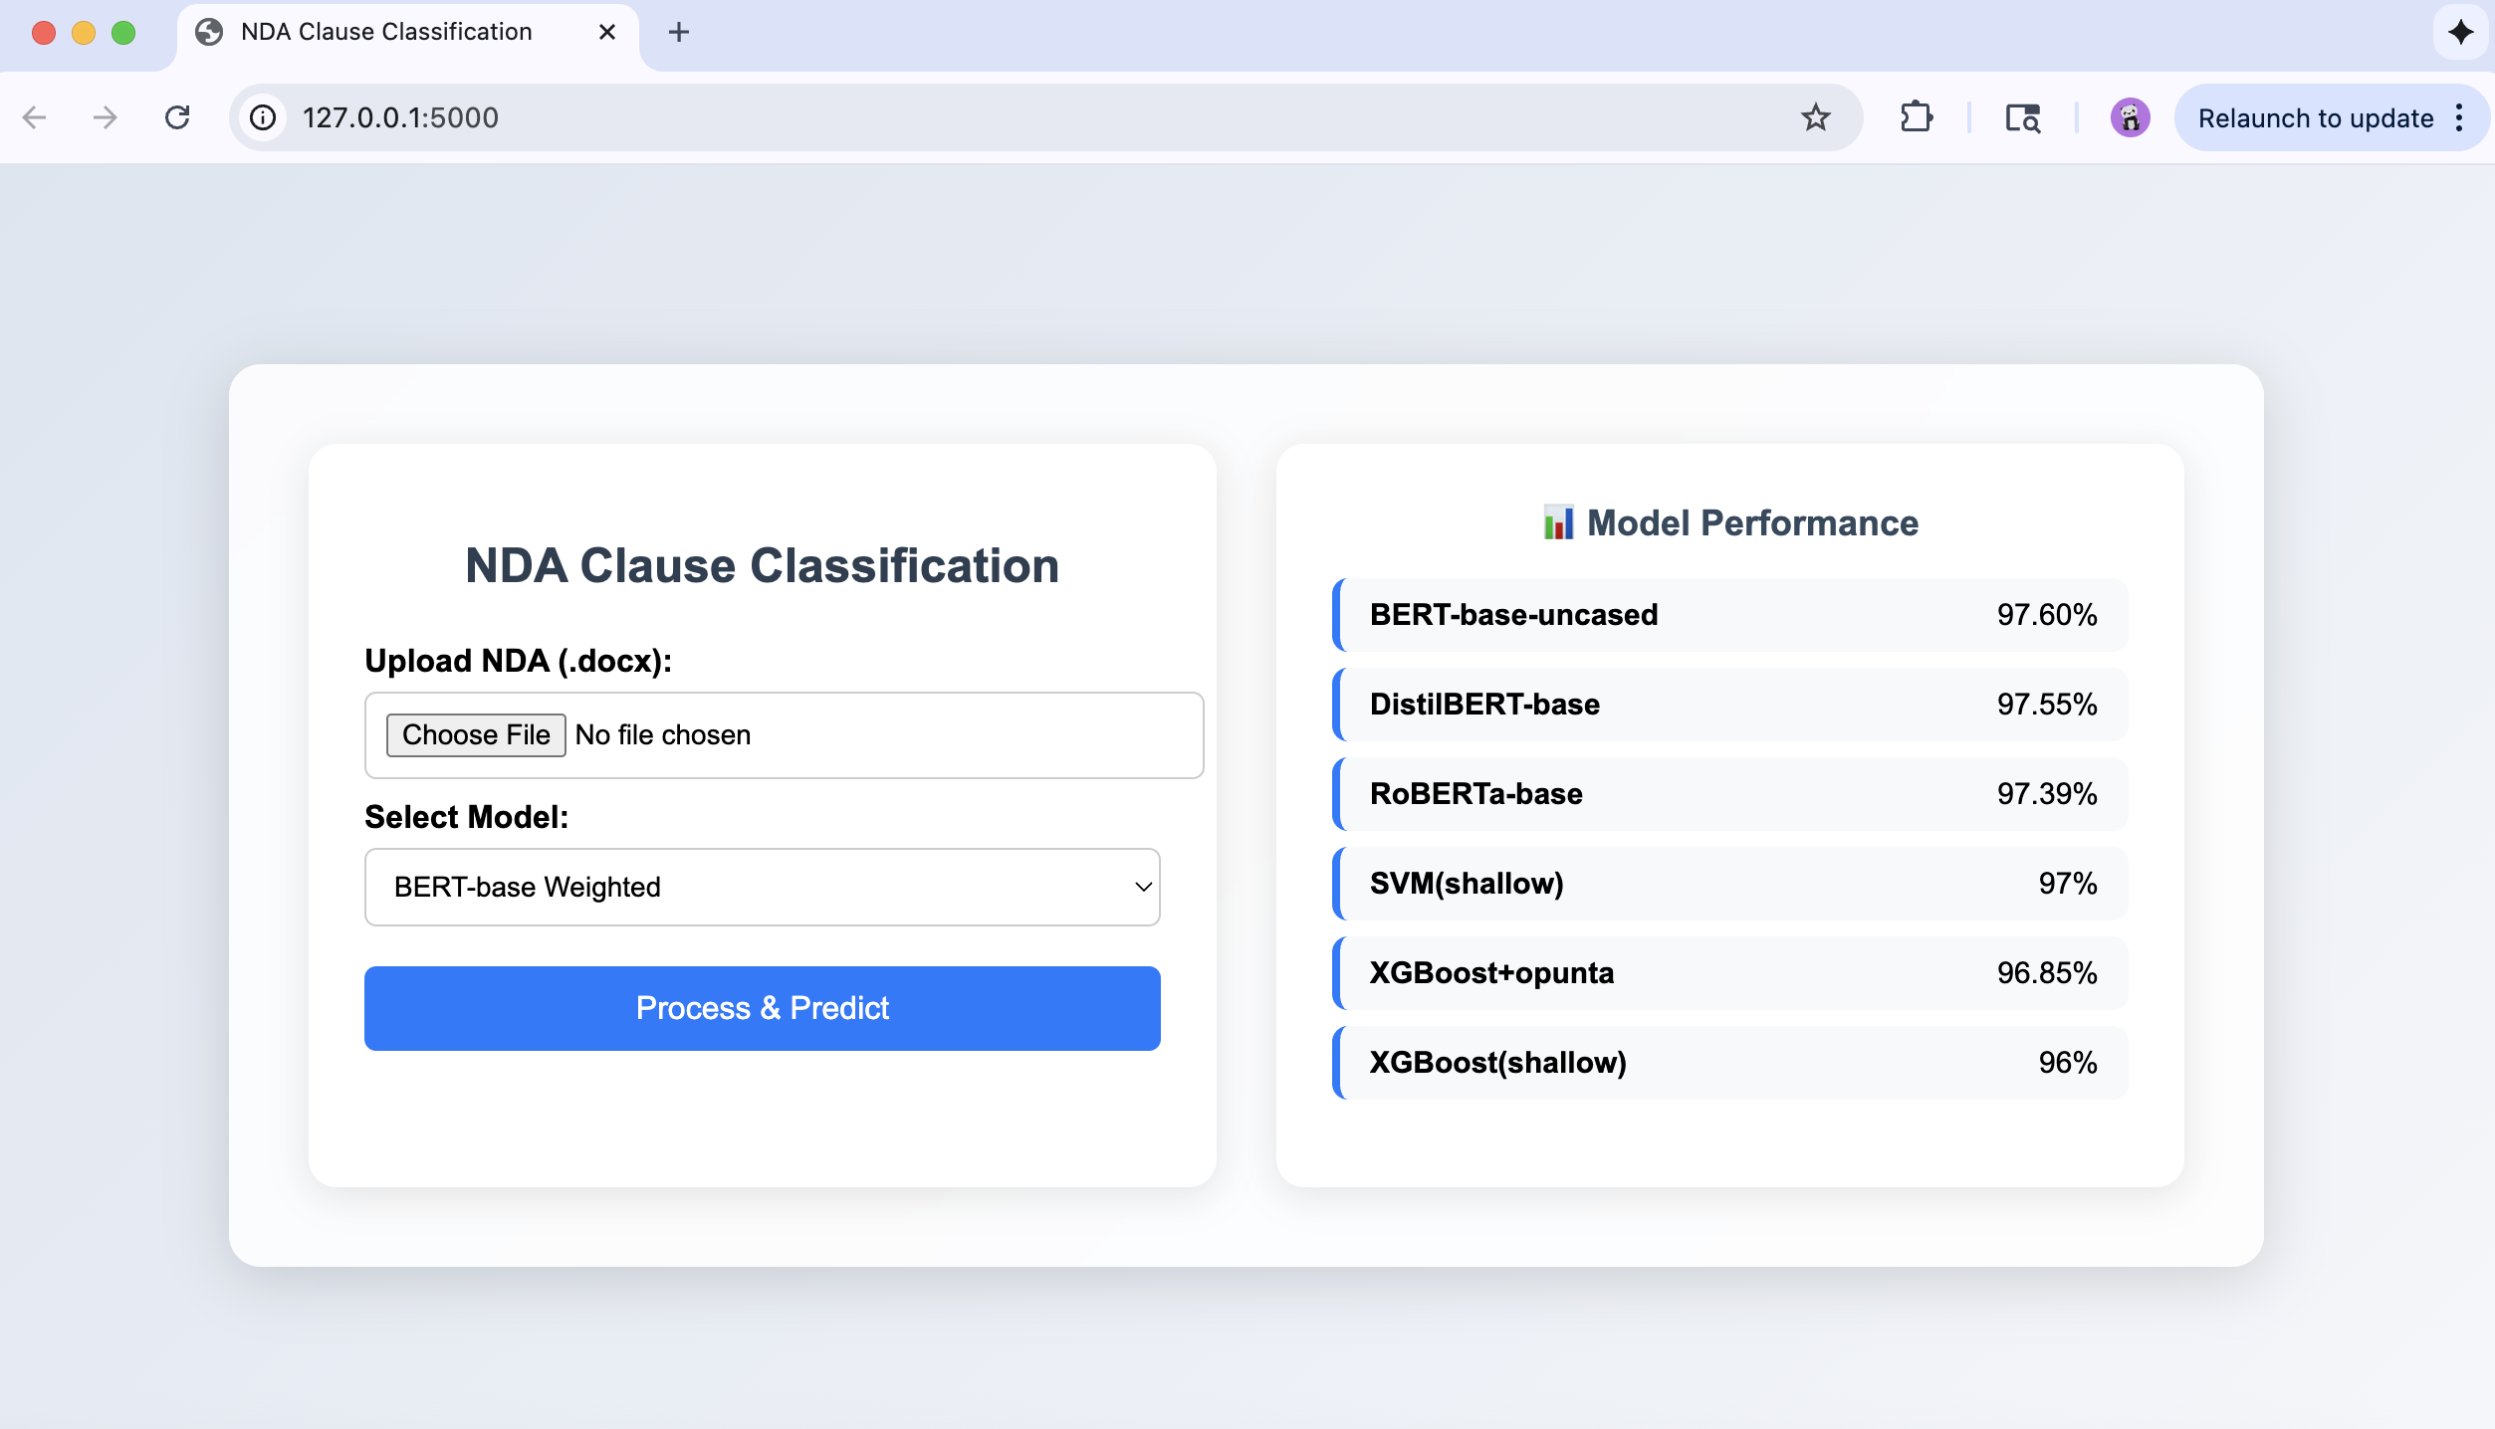
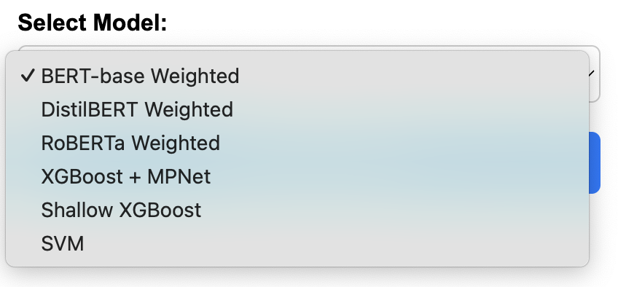
Final Delivarable web

Slide 13
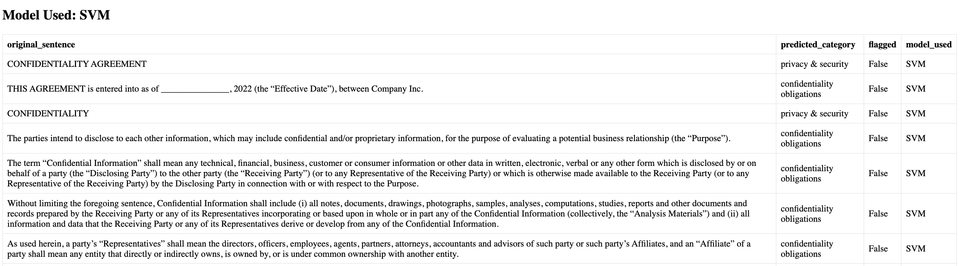
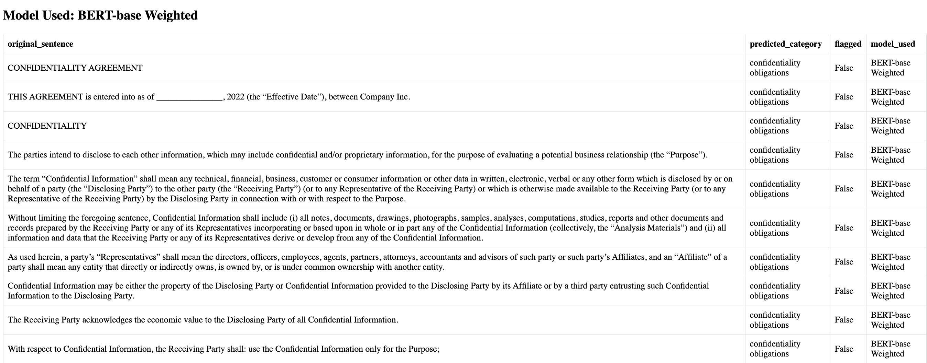
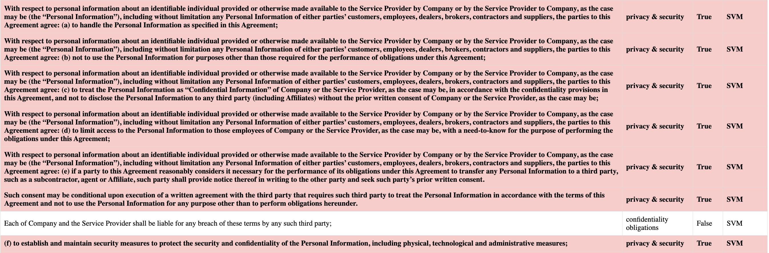
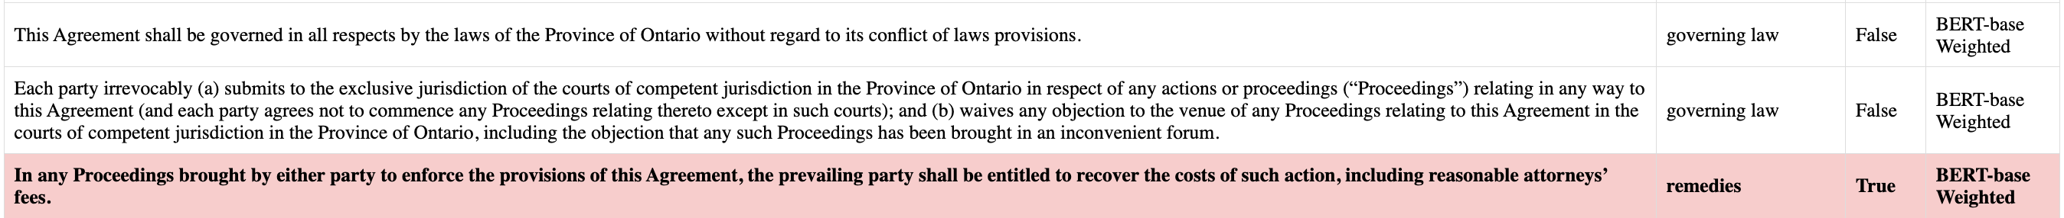
Final Deliverable web

